Slide 1
NUCLEAR POWER AND WIND-POWERED DESALINATION

Slide 2
NUCLEAR POWER DESALINATION SYSTEM
A nuclear power desalination system uses the electricity and/or heat from a nuclear reactor to purify seawater into fresh water, employing techniques like Reverse Osmosis (RO) or thermal Multistage Flash (MSF) distillation.
These dual-purpose plants offer a sustainable water source for areas with water scarcity and high energy needs, using small and large reactors to power desalination processes with competitive economics.
Safety measures, such as multiple containment barriers, prevent contamination from radioactive elements like tritium, ensuring the production of safe, high-quality fresh water.

Slide 3
KEY BENEFITS
Sustainable Water Production:
Provides a reliable, large-scale source of fresh water in arid regions or areas with high water demand.
Energy Cogeneration:
Dual-purpose plants produce both electricity and desalinated water from a single nuclear plant, increasing efficiency and economic competitiveness.
Reduced Reliance on Fossil Fuels:
Offers a clean energy alternative to fossil fuels for desalination, contributing to a lower carbon footprint.

Slide 4
SAFETY AND CHALLENGES
Contamination Prevention:
Multiple loops and heat exchangers are used to create barriers between the radioactive primary coolant and the seawater, preventing contamination.
Tritium Control:
Engineers monitor pressure differentials and implement safety measures to control tritium, a radioactive isotope of hydrogen, which could otherwise contaminate the product water.
Public Acceptance:
While safety measures are robust, public perception and acceptance remain significant factors in the deployment of nuclear desalination systems.
Current Examples

Slide 5
India:
The Kalpakkam plant operates a hybrid MSF/RO system, demonstrating the successful integration of nuclear power with advanced desalination techniques.
Global Trends:
Many countries are investigating the use of Small Modular Reactors (SMRs) for desalination due to their adaptability and efficiency, potentially expanding nuclear desalination capabilities worldwide.

Slide 6
HOW IT WORKS
Heat and Power Generation:
A nuclear reactor generates heat, which is used to create steam for both producing electricity and driving desalination processes.
Desalination Technologies:
Thermal Methods: Technologies like MSF or Multi-Effect Distillation (MED) use the steam to heat seawater, evaporate it, and then condense the vapor into fresh water, leaving the salt behind.
Membrane Methods: Reverse Osmosis (RO) uses pressure to force water through a semi-permeable membrane, separating it from the salt and other minerals.
Hybrid Systems: Many modern systems combine thermal and membrane processes for greater efficiency.

Slide 7
WIND-POWERED DESALINATION
A wind-powered desalination plant uses the kinetic or electrical energy from wind turbines to remove salt and other impurities from seawater or brackish water, producing fresh water.
These systems offer a sustainable, environmentally friendly alternative to fossil-fuel-powered desalination, especially for coastal regions and islands, but require careful integration to address the intermittent nature of wind energy and the high power demand of desalination processes.

Slide 8
WIND-POWERED DESALINATION HOW IT WORKS
Energy Source: Wind turbines generate electricity or mechanical power from the wind.
Desalination Method: This energy then powers a desalination unit, most commonly a reverse osmosis (RO) system, to separate salt from water.
Types of Systems:
Electrical Drive: The wind turbine generates electricity, which is then used by an electric motor to power the pumps and other equipment in the desalination plant.
Direct Mechanical Drive: In some designs, the wind turbine's mechanical energy is directly transmitted to a high-pressure pump via a gearbox, bypassing electricity generation.

Slide 9
ADVANTAGES
Sustainability: It reduces reliance on fossil fuels, lowering CO2 emissions and environmental impact.
Cost Reduction: Can lower operational costs by utilizing a free and abundant energy source.
Environmental Benefits: Leads to lower overall carbon footprint compared to conventional desalination methods.

Slide 10
CHALLENGES
Intermittency: The variable nature of wind requires strategies like energy storage (batteries), connection to the national grid, or smart system integration to ensure a continuous water supply.
Integration Complexity: Matching the fluctuating wind power with the consistent, high-energy demands of the desalination process is critical for system efficiency.
Scalability: Requires large-scale wind resources, and integration with existing energy infrastructure.
Potential Applications
Coastal Areas and Islands: These are prime locations due to abundant wind resources and high demand for freshwater.
Off-Grid Solutions: Stand-alone systems can provide water in remote areas without access to the national electricity grid.

Slide 11
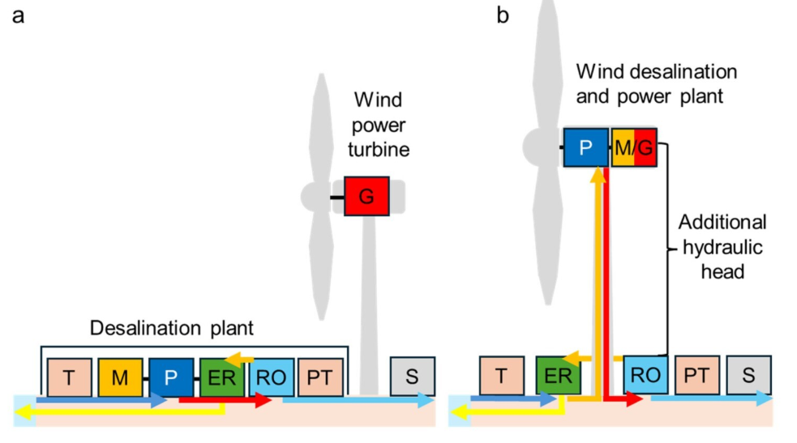
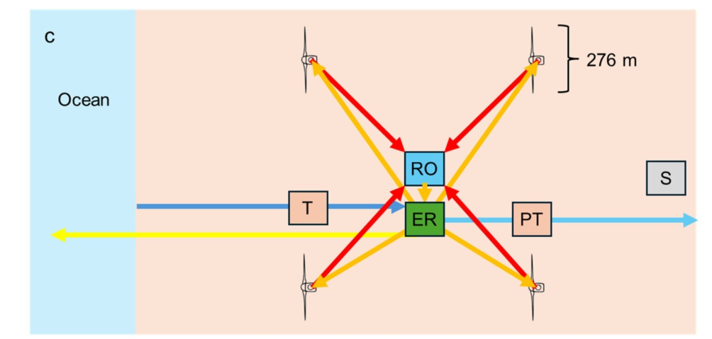
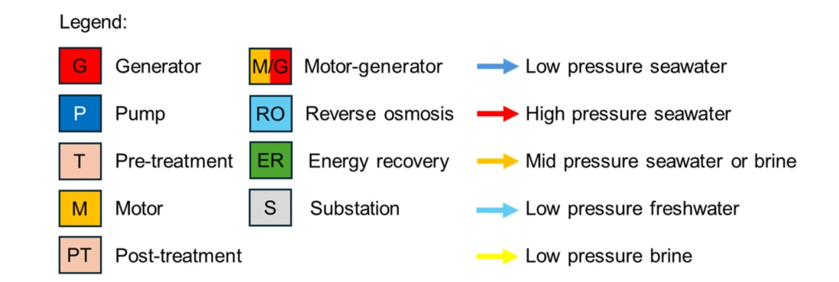

Slide 12
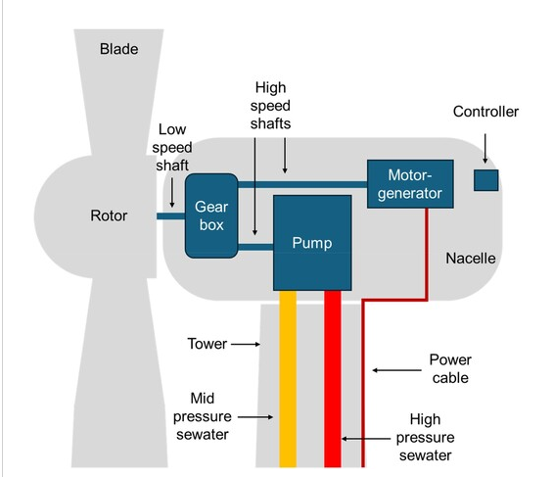
WIND DESALINATION AND POWER TURBINE NACELLE

Slide 13
Methodology
Figure 1 presents the conventional wind-powered desalination and the proposed wind desalination and power (WDP). Conventional wind powered desalination (Figure 1(a)) uses wind power turbines to generate electricity.
The electricity is then used to desalinate seawater with a pump powered by an electric motor. The desalination plant is also connected to the national grid and can desalinate seawater using electricity from other sources. The WDP plant (Figure 1(b)) has the pump built inside the wind turbine’s nacelle and connected both to the turbine blades and a motor-generator through the gearbox.
The advantage of this arrangement is that the pump transfers the kinetic energy of the wind to hydraulic energy, which can also be powered by a motor. During high wind speed periods, the pump and generator can operate at total capacity, pumping water and generating electricity.

Slide 14
4. The possibility of operating the generator as a motor reduces the costs of having two separate equipment (a generator and an engine). To avoid cavitation in the pump 160 meters above the ground, pressurised water must be available at the pump’s inlet.
5. To supply this requirement, the energy recovery (ER) system transfers the medium pressure from the RO membranes’ brine outlet to the incoming seawater to reach the turbine’s nacelle at the volume and pressure needed.
6. An auxiliary boost system in the ER system is required to provide the initial pressure for the water to raise to the wind turbine and prime pressure and cover the overall operational range of the system. The output pressure of the pump in the nacelle should be around 16 bar smaller than the pressure in the RO plan (65 bar), as the nacelle is 160 meters above the RO plant

Slide 15
Figure 2 presents the inside of the proposed WDP turbine nacelle. It consists of several components.
The gearbox transfers the rotational force from the low-speed shaft connected to the wind blades to the two high-speed shafts connected to the pump and generator.
This arrangement increases the operational flexibility of both the pump and motor-generator. It also allows the motor-generator to propel the pump when there is no wind, consuming electricity from the grid.
For this reason, the pump and motor-generator should have the same capacity. We propose a synchronous generator because: (i) it provides full control over power quality and grid compatibility, (ii) enables operation over a wide range of wind speeds, (iii) allows the operation of the generator as a motor.
A significant challenge is to accommodate the gearbox, pump and motor-generator in the nacelle without substantially increasing its weight, volume and cost.
A description of the WPD plant applied in this paper is described in Table 1. The energy losses in the pipes are neglected as the distance between the high and medium pipelines is small.

Slide 16

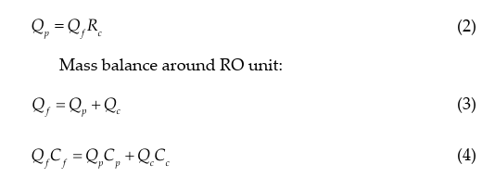
In the following, we present the equations that describe the salt separation and permeate production rate in a typical RO membrane based on the transport mechanism of solute and solvent at a steady state.
For given pump power and feed pressure, the feed flow rate can be calculated from:
where Qf , Pf , Pw , and ηp are the feed flow rate, the feed pressure, wind power, and pump efficiency, respectively. For the assumed recovery rate (Rc ), the permeate production rate (Qp ) is computed as follows:

Slide 17
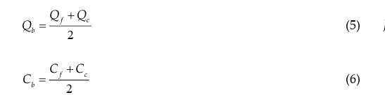
where Qc , Cc , and Cp are the brine flow rate, brine salinity, and permeate salinity, respectively. The flow rate of bulk fluid and its concentration are approximated by:

